Slide 1
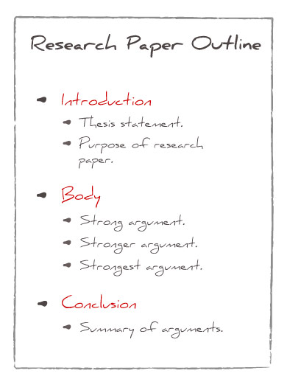
Paper Outline
Writing Techniques

Slide 2
Outlining a Research Paper
With the extended length of a research paper and the use of numerous sources, you must construct an outline in advance. An outline is like a road map or GPS directions for your writing. It leads you step-by-step through your evidence to prove your thesis.
Your thesis statement should give direction & focus to your outline.

Slide 3
“Key Terms” Or “Code Words”
Identify “key terms” or “code words” as you are researching – ideas, words, events – that are common in the vocabulary of the sources that you are using; these “key terms” or “code words” can suggest major areas of information that are needed to support your thesis and will be major sections of your outline.

Slide 4
Organizing By
“Key Terms” Or “Code Words”
The ideas, information, and quotes that you record when you take notes are indicative of what is interesting to you about the topic you are researching.
Once you are done with the note-taking, you can review each set of notes to see what categories of information you took down.

Slide 5
Organizing By
“Key Terms” Or “Code Words”
Say, for example, that you took notes from sources by five different writers —A. Baraka, M. Twain, A. Walker, J. Baldwin, and T. Morrison. You should have a set of notes from each one of those authors (using the techniques in the “Research Writing Note-taking Process” PowerPoint.
Look through each set of notes and try to identify the major areas of information that you wrote down that are common in each set of notes. Identify those areas by using “Key Terms” or “Code Words.”

Slide 6
Organizing By
“Key Terms” Or “Code Words”
Say that in each of your five sources—using my sample thesis topic of the blues in the 1960s— that each the five writers discusses the connections between African American blues musicians and white audiences and musicians.
The “key term” or “code words” I could use to identify that area of information could be: “building of bridges between black and white Americans”

Slide 7
Organizing By
“Key Terms” Or “Code Words”
Now I can create a new set of notes focused on the key terms or code words that I identified as: “building of bridges between black and white Americans”
Then, I can go back through my notes from the five writers and create a new set of notes that lists all the page numbers where each source addressed that particular area of information.

Slide 8
Organizing By
“Key Terms” Or “Code Words”
So, my new set of notes organized around an area of information might look like:
“Building Bridges Between Black And White Americans”
Source #1: A. Baraka— pgs. 12, 19-21, 56, 87-88
Source #2: M. Twain—pgs. 211-213, 300-304
Source #3: A. Walker— pgs. 12-13, 54, 67, 89-90
Source #4: J. Baldwin— 112, 148, 309-310, 388
Source #5: T. Morrison— 17, 21, 76, 89, 99, 109

Slide 9
Organizing By
“Key Terms” Or “Code Words”
Now I have all the references that I found to this area of information in one place.
It shows that this is an area of significance for the topic of the blues in the 1960s — which means it may be useful in constructing a thesis statement, that I have the information to develop this area in my argument, and it is organized together to be inserted into my outline.

Slide 10
Constructing An Outline
Hierarchy – identify a hierarchy or ranking of major & minor ideas – what order is most effective in presenting information & ideas to the reader?
Outlines should be flexible – you can rearrange, add, and delete in response to writing your draft or finding new sources.

Slide 11
Constructing An Outline
Everything in the outline should relate back to the thesis
You have two options with outlining: topic or sentence. In the first, you use bulleted ideas and code words; in the second, you write out full sentences.

Slide 12
Headings & Subheadings in Outlines
Each major section of an outline is labeled with a capital Roman numeral (I.; II.: III.; IV.).
Each heading is then broken up into subheadings. The more specific you get with the information you are entering into the outline, the more subheadings you will have.
The first level of subheading is indicated by a capitol letter (A.; B.; C.). The next level is indicated by an Arabic numeral (1.; 2.; 3.)
See next slide for examples.

Slide 13
Headings and Subheadings
I. Heading = major section of paper
A. Subheading = main point you want to make about heading
1. specific point to support
2. 2nd specific point to support
3. direct quote to support
B. 2nd Subheading = next main point you want to make about heading
1. specific point to support

Slide 14
Breaking Down a Thesis Statement
Using the following thesis statement, we can break it down into the major headings needed to support it in an outline.
“During the 1960s, the blues had a major influence on American culture, in terms of the artistic evolution of popular music and in the building of bridges between black and white Americans.”

Slide 15
Breaking Down a Thesis Statement
An outline to support this thesis would have to include the following “headings” or major areas of information:
Introduction with Thesis Statement
Background Info on Blues and 1960s
Artistic Evolution Of Popular Music
Building Of Bridges Between Black And White Americans
Conclusion
MLA Works Cited

Slide 16
Sample Outline
Please see Course Documents page for a “Sample Research Paper Outline” using the sample thesis statement from this PowerPoint.

Slide 17
Resources for Thesis Statements & Outlines
Little Seagull Handbook — pgs. 10-11; 81-82
OWL@perdue.edu
Openwriting.org

Slide 18
Ask Questions!!!!!
Once you have engaged with the research process, you should have questions. E-mail or call me!

Slide 19

Finally!

